Slide 1
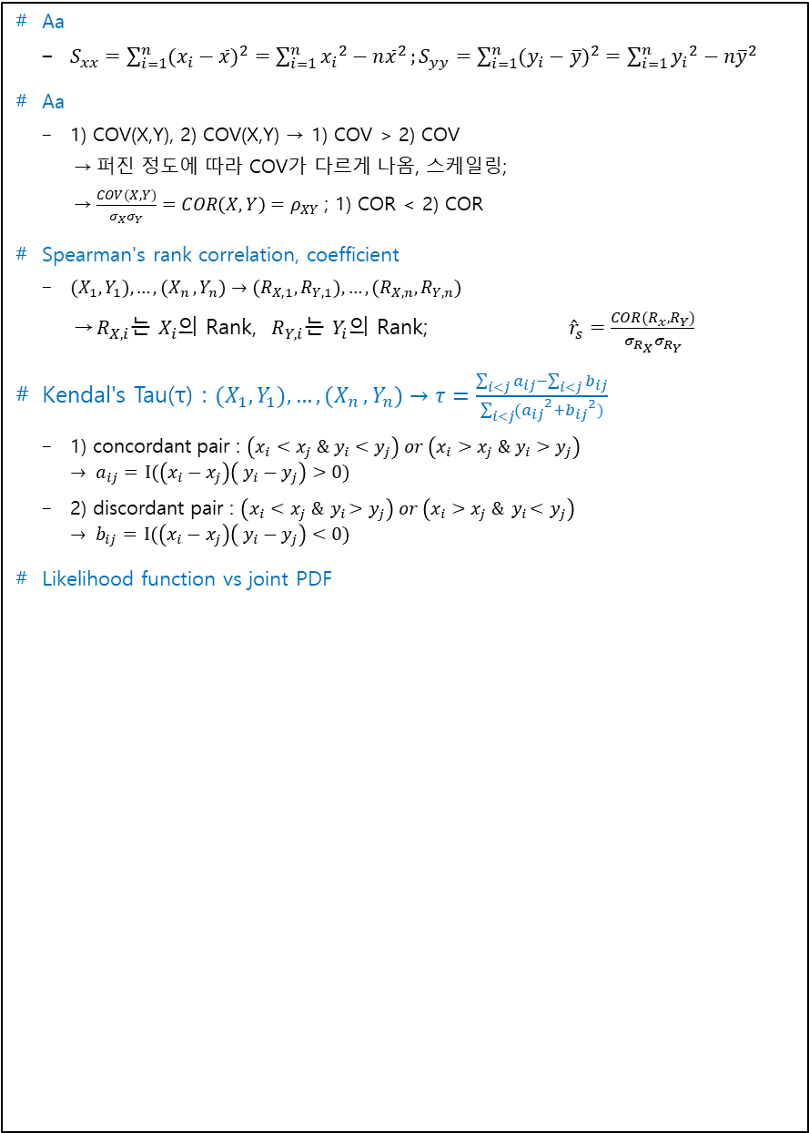
Aa
$S_{xx}=\sum_{i=1}^{n}{{(x_{i}−\overline{x})}^{2}}=\sum_{i=1}^{n}{{{x_{i}}^{2}−n\overline{x}}^{2}};S_{yy}=\sum_{i=1}^{n}{{(y_{i}−\overline{y})}^{2}}=\sum_{i=1}^{n}{{{y_{i}}^{2}−n\overline{y}}^{2}}$
Aa
1) COV(X,Y), 2) COV(X,Y) → 1) COV > 2) COV
퍼진 정도에 따라 COV가 다르게 나옴, 스케일링;
$\frac{COV(X,Y)}{σ_{X}σ_{Y}}=COR\left(X,Y\right)=ρ_{XY}$; 1) COR < 2) COR
Spearman's rank correlation, coefficient
${(X}_{1},Y_{1}){, …,(X}_{n},Y_{n})→{(R}_{X,1},R_{Y,1}), …,{(R}_{X,n},R_{Y,n})$
$R_{X,i}$는 $X_{i}$의 Rank, $R_{Y,i}$는 $Y_{i}$의 Rank; ${\hat{r}}_{s}=\frac{COR(R_{x},R_{Y})}{σ_{R_{X}}σ_{R_{Y}}}$
Kendal's Tau(τ) : ${(X}_{1},Y_{1}){, …,(X}_{n},Y_{n})→τ=\frac{\sum_{i<j}{a_{ij}}−\sum_{i<j}{b_{ij}}}{\sum_{i<j}{{(a_{ij}}^{2}}+{b_{ij}}^{2})}$
1) concordant pair : $\left(x_{i}<x_{j} \& y_{i}<y_{j}\right) or \left(x_{i}>x_{j} \& y_{i}>y_{j}\right)$ $→ a_{ij}=$ $I(\left(x_{i}−x_{j}\right)\left( y_{i}−y_{j}\right)>0)$
2) discordant pair : $\left(x_{i}<x_{j} \&{ y}_{i}>y_{j}\right) or \left(x_{i}>x_{j} \&{ y}_{i}<y_{j}\right)$ $→ b_{ij}=$ $I(\left(x_{i}−x_{j}\right)\left( y_{i}−y_{j}\right)<0)$
Likelihood function vs joint PDF

Slide 2

SSE와 SAD의 유도
SSE 수식 유도 (수학적으로 미가 good, 이상치엔 민감(오차를 제곱하기 때문)) $SSE\left(μ\right)=\sum_{i=1}^{n}{{\left(Y_{i}−μ\right)}^{2}}→f_{1}\left(μ\right)=\sum_{i=1}^{n}{{\left(Y_{i}−μ\right)}^{2}}$ $\hat{μ}=argmin_{μ}\sum_{i=1}^{n}{{\left(Y_{i}−μ\right)}^{2}}, \frac{∂f}{∂μ}=2\sum_{i=1}^{n}{\left(Y_{i}−μ\right)\left(−1\right)}=0$ $→\sum_{i=1}^{n}{Y_{i}}=nμ,\hat{μ}=\frac{1}{n}\sum_{i=1}^{n}{Y_{i}}$
SAD 수식 유도 (이상치에 대해 민감 X, but, 미분불가능) $SAD\left(μ\right)=\sum_{i=1}^{n}{\left|Y_{i}−μ\right|}=\sum_{i=1}^{k}{\left|Y_{i}−μ\right|}+\sum_{i=k+1}^{n}{\left|Y_{i}−μ\right|}$ $(Y_{1}≤⋯≤Y_{k}≤μ≤Y_{k+1}≤⋯≤Y_{n}),$ $=\left(2k−n\right)μ+\sum_{i=1}^{k}{\left(−Y_{i}\right)}+\sum_{i=k+1}^{k}{Y_{i}}$ $\text{(}\text{if} \text{n} \text{is} \text{even}\text{)}→Y_{\frac{n}{2}}≤μ≤Y_{\frac{n}{2}+1},\text{(}\text{if} \text{n} \text{is} \text{odd}\text{)}→μ=Y_{\frac{n+1}{2}}\}$
열벡터, 내적, 정사영
$1)$ $x \text{or} x={\left(x_{1},x_{2},⋅,x_{n}\right)}^{T}=\left(\begin{matrix}x_{1} \\ x_{2} \\ ⋮x_{n}\end{matrix}\right)$

